Slide 1
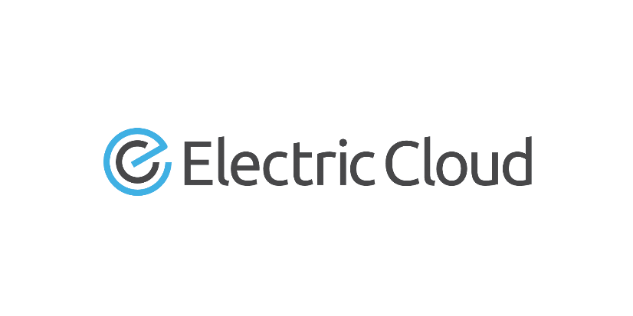
Continuous Integration as a Centralized Service using ElectricCommander
Lucas Gravley / Daniel Perez October 2014
Notes:
Who we are
admins for the deployment of EC across HP
This lecture will encompass the benefits and flaws of deploying EC as a centralized service (not flaws with ec, just with creating centralized service)
We will go into detail about some of the major topics of creating this ecosystem
Would like to state: EC is not our only option, HP does use other ci/cd including open source and internal solutions
We develop on every platform for over 300k employees

Slide 2



Topics
About Us
User Experience
Benefits
Our Challenges
Infrastructure
Simplified Security Model
Policy Driven Process
Notes:
Explain we will go into detail about all topics
Open for questions along the way
About us – who we are, what need did we have
User exp – before and after centralized model
Benefits – of centralized model, smaller footprint, manageable by small team, security
Drawbacks – single point of failure, need of strong support
Infrastructure – hw needed to implement this
Simplified and policy – core backbone for this to work

Slide 3



Hewlett-Packard Deployment
Longstanding Patron of ElectricCommander
Self-Service Deployment
Users control their builds
Users control their personal environment
World Wide Deployment
User counts in the thousands
Millions of production builds a year
Non-Stop / High Availability Environment
Used by all Facets of HP
Everyone in HP can use ElectricCommander
HP R&D
HP IT
HP Business
Notes:
User of the tool since 2008
All major geographic regions are represented
All internal HP is allow to use EC

Slide 4


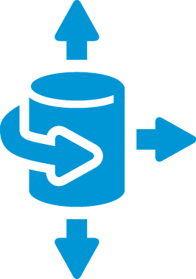
What We Needed
Common Environment
Repeatability
Less admins needed
Support
Reduce Redundancy
Scalability
Deployment
Needs to be deployable to all HP
Non-Stop / High Availability Environment
Handle thousands of users
Cost Effective
Everyone in HP can use
Reduce solutions
Work with other tools (integrations)
Smaller Footprint
Notes:
We needed CI as a service
Needed a tool that could handle the shear size
Needed support that open source could not provide
Had to adapt to environment
Had connections to open source and industry standards
Was cost effective

Slide 5






User Experience Before
Before
Users Build Env.
Users
How did you break this?!
Users Build Env.
Users
Admin
Web
Users Build Env.
Admin
DB APP
Run Away!
Web
Users
DB APP
Web
Admin
Users Build Env.
DB APP
Users Build Env.
Web
DB APP
Notes:
Small groups with their own open source or bought programs
Lots of redundancy
Under used environment
Some are better than others…

Slide 6


User Experience After
DB
User
Regional WEB
Users Build Env.
Users Build Env.
Regional WEB
User
APP
User
Regional WEB
Users Build Env.
Users Build Env.
Regional WEB
User
Admin
Notes:
That’s us….
Centralized service
Users still in control
Reduced footprint

Slide 7



Benefits
Smaller hardware footprint
Manageable by small team
Developers sustain innovation
User Experience
Security
Repeatability
Savings
Notes:
---HW--- 1 cluster for DB ,1 Cluster for Application ,Web servers clusters where your users are to reduce latency
---small team--- Only need a few experts on the tool instead of 1 for every team trying to use the tool
---Developers--- This allows teams to work on their jobs and not updating/sustaining the build environment
---user experience--- Everyone has similar experience using the tool allowing teams to work together and share ideas via forum
---security--- Enforce policies that make sure environment requires login, and users data is safe, deploy hp company standards
---repeatability--- if people move teams/orgs they are familiar with rules and setup

Slide 8


Challenges of Centralized Deployment
High Availability Model
Support
Requires Standardized Model
Standard Build Process
Notes:
If application fails, all users are down
Mission critical app
Loss of revenue can come fast…
Users can not customize as they don’t have the privilege in the system
Need users to comply with our settings (job ids /security models)
Need 24 7 support
Getting used to original privilege takes some time
Standard customization can work for everyone (need to work with admins to get the changes you want)
User learning curve of how pdeit admins EC
State that these are not flaws of EC but of central deploy

Slide 9
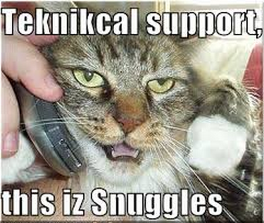
Support…
Notes:
OUR SUPPORT - That’s what im guessing they look like
Need run books and playbooks
Usually support has high turnover

Slide 10

Infrastructure
Dedicated Hardware
Need separate Hardware for
Database
Application
Front End
Larger machines needed for larger load
High Availability is a necessity
Notes:
Need large machines no one else can destroy
Limit failure by separating infrastructure
Large machines needed for huge load
Active/passive needed
Commander 5.x with active/active is a savior
Need web servers where your users are (latency , local storage)
Latency is the enemy
Move to mature cloud?

Slide 11
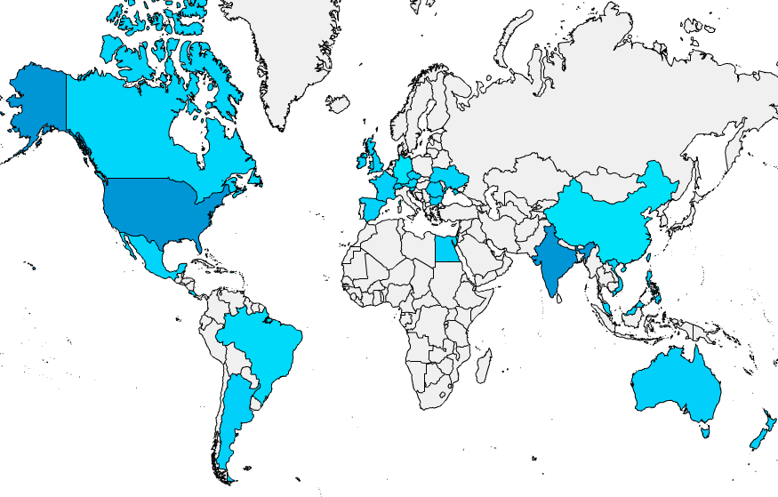


= APP+DB
= Webserver
Notes:
That’s us….

Slide 12


Simplified Security Model
How to secure your system
Notes:
We will go into a little depth on the necessary projects needed to create CI as a service

Slide 13


Simplified Security Model
Needed to run as a centralized service
Policy
Documentation
Security
Protection from other users
Notes:
Limit user access to control environment
Deployment of policy takes thought and consideration
Need forums and documentation to empower the users
Limiting user access creates security to other users
Users can not see other users artifacts
This prevents users from accidentally destroying system (deleting other users artifacts)
You can assume some employees will try something destructive (good or bad intentions)

Slide 14
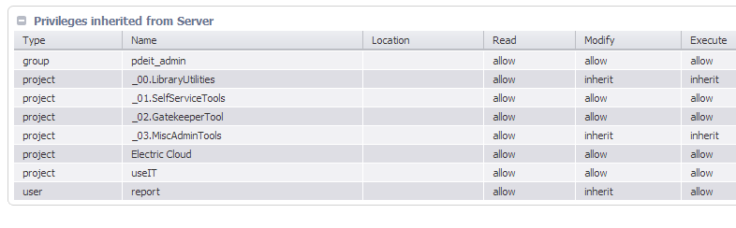
In Depth Simplified Security Model Cont.
Need to create Basic groups:
Self-service_users
All_users
All_projects
All_gatekeepers
Notes:
The groups that you will need
Need to have users added to groups by projects like privilege user request
Gatekeeper request (allows them to create continuous sentry schedules and the such)
---Note: this is important since we don’t want everyone creating schedules firing off every few seconds

Slide 15
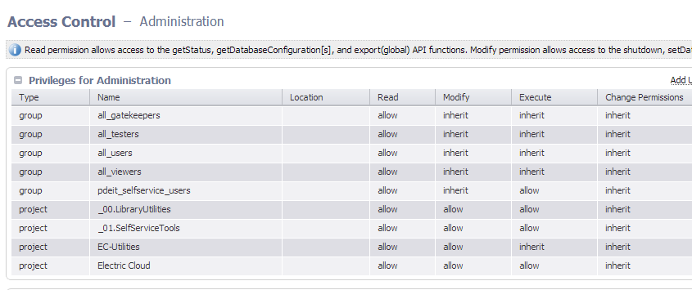
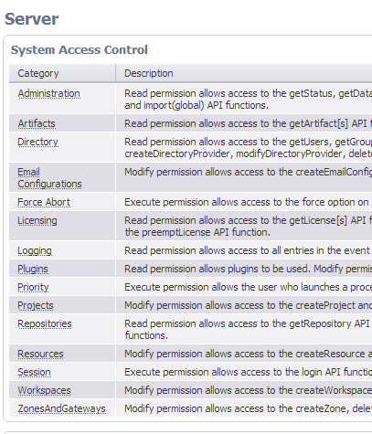
In Depth Simplified Security Model
Notes:
You need to set world permissions from the admin tab and set them for everything in the tool
Specific groups get access like priv_users /all_gatekeepers/all_projects
While everyone only has read on certain objects some groups have higher access rights

Slide 16

Policy Driven Process - Necessary Projects
The Basics of creating the Self-Service Model
Notes:
We will go into a little depth on the necessary projects needed to create CI as a service

Slide 17

Projects
Privilege user request
Self-Service Projects
Library Utilities
Admin Tools
Smoke Test
Notes:
Need base line projects
Priv User project gives users perms needed to allows users to create base line artifacts (resource/workspace/gateway/project/zones)
Self Serve allows them to create base artifacts
Lib Util is common procedures to make changes to system (export/import/copy/rename/factory steps/common problems with tooling)
Admin is super important! (cleanup /maintenance/policy/reporting)
Smoke test allows us to keep a base line of system and verify all is working

Slide 18
Privilege User request
This is only project a user can see before given access (plus what their team has given them)
Prevents users from gaining access to creation in ElectricCommander
Before this, no real access
Checks with manager to see if they are allowed to build
Pushes teams to control their environment
Notes:
This is crucial in centralized service
Allows teams to govern their own access
Once someone shows competence, they are then given access from their mgmt

Slide 19
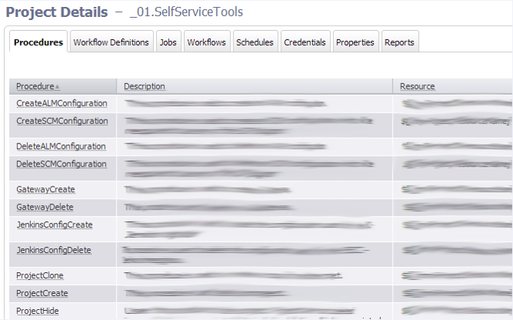

Self-Service Tools
Notes:
Creation of all artifacts
Creation of plugin creds

Slide 20
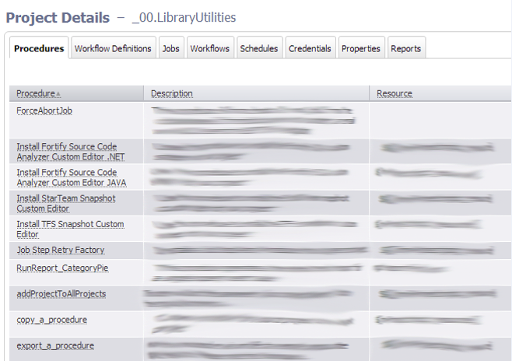
Library Utilities
Notes:
This project holds factory jobs
Imports/exports
Custom editors
Create reports
Common EC problems

Slide 21
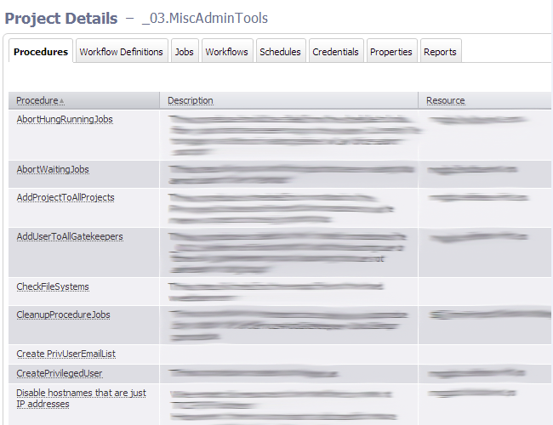

Admin Tools
Notes:
Cleanup of logs
Cleanup of jobs
Cleanup of workflows
System metrics
User metrics
Monitors? Backups?

Slide 22

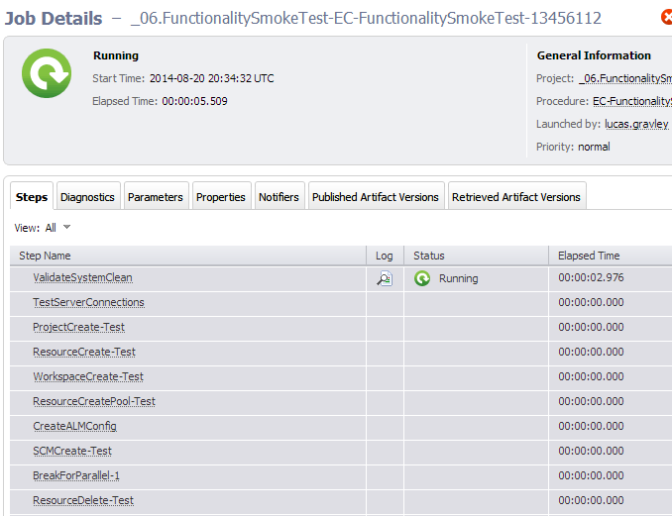

Functionality Test
Notes:
This is needed to validate the system is functional all performs as expected
Very useful in version testing / Recovery
Can be used as a baseline to validate system health
Verifies Building blocks for our users (rus all self serve lib utils and common issues)
!!!!! This is powerful feature of commander that you can create wrappers of these and continue to deploy!!!!

Slide 23
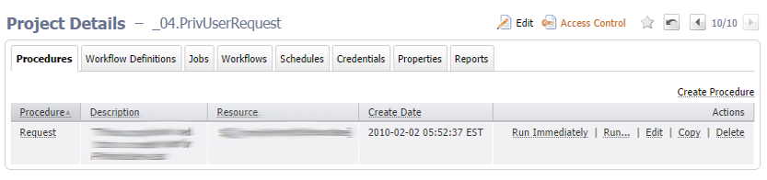
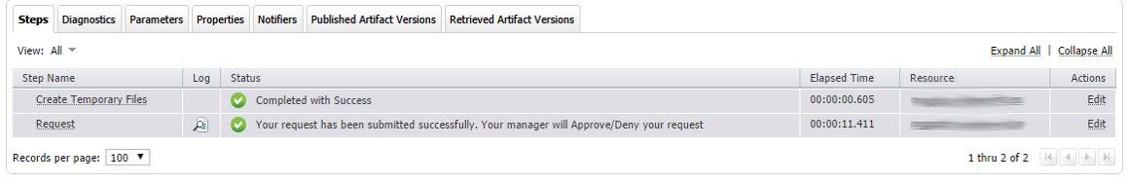
Typical New User Experience
Regional WEB
New User
Notes:
User connects to closest web server WW
Only project they can see would be priv user or anything their team has already given them access
This will contact mgmt

Slide 24

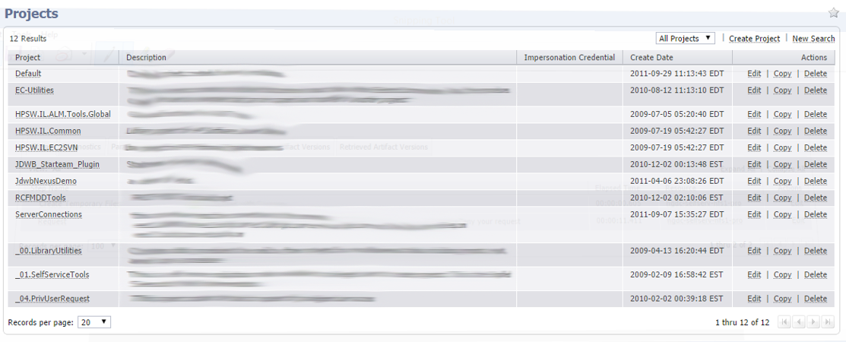
Typical New User Experience cont.
New Users Manager
New User
Notes:
This is the management chain allowing certain users the ability to create
They can establish who and how many people have control

Slide 25
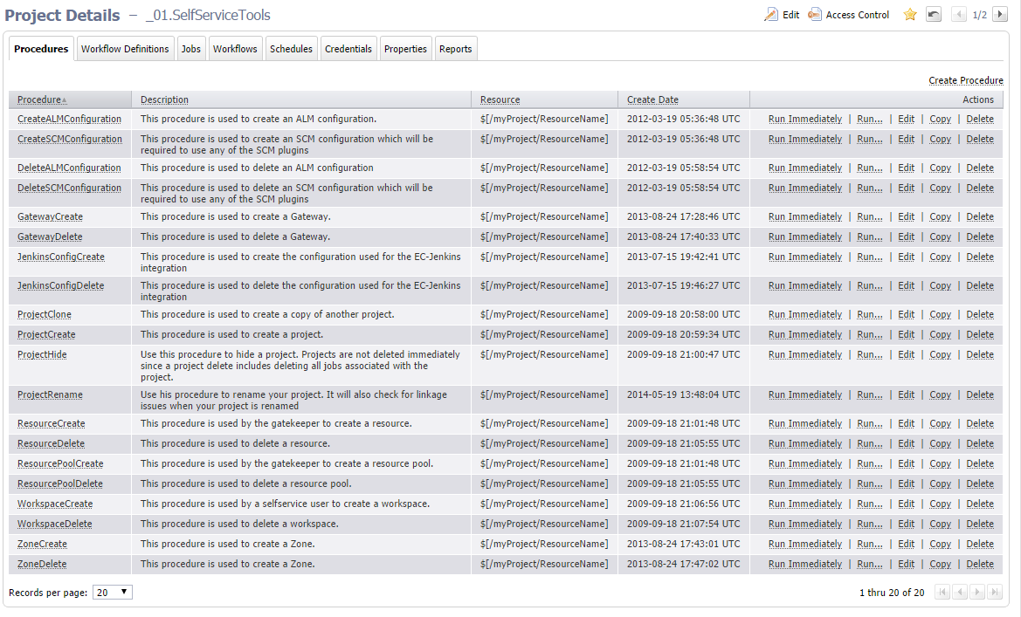
Typical New User Experience cont.
New User
Notes:
Now has access for himself or team to create objects in EC
Once he can access this project, the environment is in their hands

Slide 26


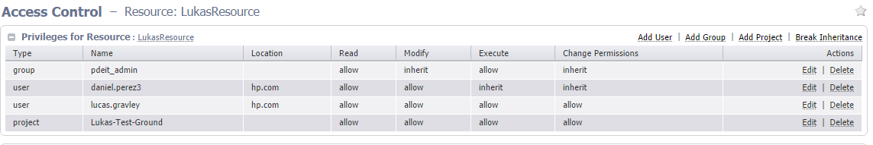
Typical New User Experience cont.
New User
Colleagues
Build Env
Notes:
They can now add their colleagues to the new resources workspaces etc
They have control of their personal security
They can build out their projects/ create CI and build out to their business needs

Slide 27

Cleanup Policies

Slide 28
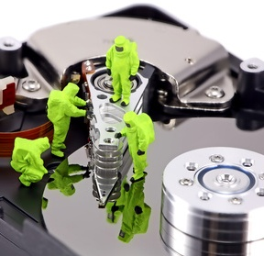
System Cleanup
Cleanup is necessary!!!
Log Management
Job Management
Workflow Management
User Management
Notes:
A system this size needs to be maintained daily
The main 4 cleanups you should keep an eye on
Increase performance and usability
Robust and usable

Slide 29

Job and Log Management
TPS Reports

Slide 30
Jobs and Logs Management
You must follow the rules to be safe
Build a policy
Query the system for all jobs
Cleanup Logs first
Delete the jobs
Run as often as jobs build up
Evaluate your system
Inform the Users!
Post the policy
Sticky Jobs
Most Expensive
Calculate when to run
Build a data structure
This can be done in parallel
Failure is fine at this level
If all is successful, we can delete
Never delete jobs if logs failed
Find your balance
Schedule to run at best times
Notes:
Policy includes when it will run, how long jobs are saved, exception policy,
This will help find users not following the rules
Find your system slow time
findObjects is your friend
Background delete is your friend
Word in sticky policy
10k-15k jobs a day

Slide 31
Workflow Management

Slide 32
Workflow Management
You must follow the rules to be safe
Build a policy
Query the system for all Workflows
Delete Work flows
Run as often as jobs build up
Evaluate your system
Inform the Users!
Post the policy
Sticky Workflows
Most Expensive
Calculate when to run
Build a data structure
Check for failure
Limit the amount it will delete
Find your balance
Schedule to run at best times
Notes:
Policy includes when it will run, how long jobs are saved, exception policy,
This will help find users not following the rules
Find your system slow time
findObjects is your friend
Background delete is your friend

Slide 33

User Management

Slide 34
User Management
More complex than you would believe
Build a policy
Query the system for all objects and ACLS
First pass
Second pass
Evaluate your system
Inform the Users!
Post the policy
Find the users
Most Expensive!
Calculate when to run
Build a massive data structure
Disable and mark disabled users and objects
3 object types
Delete objects
Delete users and objects
Inform users of broken objects
Notes:
Policy includes when it will run, how long users are saved, exception policy,
We use ldap/aD/other? to validate users
Find your system slow time
findObjects is your friend
Give a delete time so that nothing is immediately removed (rename objects)
Broken access is the one you need additional work to make automated

Slide 35
Questions?

Slide 36
Thank you

